Slide 1

SOFTWARE ENGINEERING AND PROJECT MANAGEMENT (CSE 227)
Department of Computer Science and Engineering
School of Engineering,
PRESIDENCY UNIVERSITY

Slide 2
Module 3: Software Testing and Quality (8 hrs) – Comprehension level
Introduction to Software Testing: verification and validation, Test Strategies for conventional Software, Validation Testing, White box Testing: Basis path testing, Black box Testing. Software Quality Assurance : Elements of software quality assurance, SQA Tasks, Goals and Metrics, Software configuration management : SCM process.

Slide 3
Software Quality Assurance (SQA)
Department of Computer Science and Engineering
School of Engineering, Presidency University

Slide 4
Software Quality Assurance (SQA) Contents
Elements of SQA
Role of the SQA Group
SQA Goals
Statistical SQA
Six-Sigma for Software Engineering
Software Safety

Slide 5
Elements of Software Quality Assurance (SQA)
Standards
Reviews and Audits
Testing
Error/defect collection and analysis
Change management
Education
Vendor management
Security management
Safety
Risk management

Slide 6
Role of the SQA Group - I
Prepares an SQA plan for a project.
The plan identifies
evaluations to be performed
audits and reviews to be performed
standards that are applicable to the project
procedures for error reporting and tracking
documents to be produced by the SQA group
amount of feedback provided to the software project team
Participates in the development of the project’s software process description.
The SQA group reviews the process description for compliance with organizational policy, internal software standards, externally imposed standards (e.g., ISO-9001), and other parts of the software project plan.

Slide 7
Role of the SQA Group - II
Reviews software engineering activities to verify compliance with the defined software process.
identifies, documents, and tracks deviations from the process and verifies that corrections have been made.
Audits designated software work products to verify compliance with those defined as part of the software process.
reviews selected work products; identifies, documents, and tracks deviations; verifies that corrections have been made
periodically reports the results of its work to the project manager.
Ensures that deviations in software work and work products are documented and handled according to a documented procedure.
Records any noncompliance and reports to senior management.
Noncompliance items are tracked until they are resolved.

Slide 8
SQA Goals
Requirements quality. The correctness, completeness, and consistency of the requirements model will have a strong influence on the quality of all work products that follow.
Design quality. Every element of the design model should be assessed by the software team to ensure that it exhibits high quality and that the design itself conforms to requirements.
Code quality. Source code and related work products (e.g., other descriptive information) must conform to local coding standards and exhibit characteristics that will facilitate maintainability.
Quality control effectiveness. A software team should apply limited resources in a way that has the highest likelihood of achieving a high quality result.

Slide 9
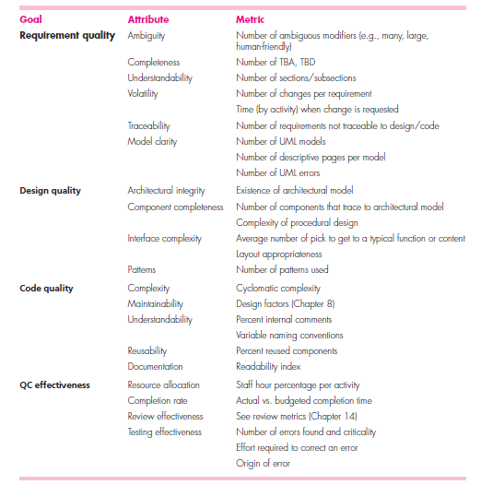
Software Quality Goals, Attributes and Metrics
Notes:
TBA AND TBD?

Slide 10
Statistical SQA
Product
& Process
Collect information on all defects
Find the causes of the defects
Move to provide fixes for the process
measurement
... an understanding of how
to improve quality ...

Slide 11
Statistical SQA
Information about software errors and defects is collected and categorized.
An attempt is made to trace each error and defect to its underlying cause (e.g., non-conformance to specifications, design error, violation of standards, poor communication with the customer).
Using the Pareto principle (80 percent of the defects can be traced to 20 percent of all possible causes), isolate the 20 percent (the vital few).
Once the vital few causes have been identified, move to correct the problems that have caused the errors and defects.
Notes:
.ikThe 80:20 ratio of cause-to-effect became known as the Pareto Principle.
The Pareto principle (also known as the 80/20 rule, the law of the vital few, or the principle of factor sparsity) states that, for many events, roughly 80% of the effects come from 20% of the causes.
eg,. 80% of work is completed by 20% of your team
80% of software problems are caused by 20% of bugs

Slide 12
Six Sigma for Software Engineering
The term “six sigma” is derived from six standard deviations - 3.4 instances (defects) per million occurrences - implying an extremely high quality standard.
The Six Sigma methodology defines five core steps:
Define customer requirements and deliverables and project goals via well-defined methods of customer communication.
Measure the existing process and its output to determine current quality performance (collect defect metrics).
Analyze defect metrics and determine the vital few causes.
Improve the process by eliminating the root causes of defects.
Control the process to ensure that future work does not reintroduce the causes of defects.
Notes:
Six Sigma is a disciplined, statistical-based, data-driven approach and continuous improvement methodology for eliminating defects in a product, process or service

Slide 13
Software Safety
Software safety is a software quality assurance activity that focuses on the identification and assessment of potential hazards that may affect software negatively and cause an entire system to fail.
If hazards can be identified early in the software process, software design features can be specified that will either eliminate or control potential hazards.

Slide 14
Case Study
Assume that you are a student member of “Software Quality - Assurance” Cell in Presidency University.
List the activities that you would perform to ensure that the functioning of the CSE department is as per standard quality requirements.

Slide 15
Software Quality Concepts Contents
What is Quality and Views of Quality
Why is Quality of “Software” important
Definition of Software Quality
Quality Dimensions
Software Quality Dilemma
Cost of Quality
Quality and Risk
Quality and Security

Slide 16
What is Quality and Views of Quality
The American Heritage Dictionary defines quality as
“a characteristic or attribute of something.”
Views of Quality
The transcendental view argues that quality is something that you immediately recognize, but cannot explicitly define.
The user view sees quality in terms of an end-user’s specific goals. If a product meets those goals, it exhibits quality.
The manufacturer’s view defines quality in terms of the original specification of the product. If the product conforms to the spec, it exhibits quality.
The product view suggests that quality can be tied to inherent characteristics (e.g., functions and features) of a product.

Slide 17
Why is Quality of “Software” Important
In 2005, ComputerWorld lamented that
“bad software plagues nearly every organization that uses computers, causing lost work hours during computer downtime, lost or corrupted data, missed sales opportunities, high IT support and maintenance costs, and low customer satisfaction.
A year later, InfoWorld wrote about the
“the sorry state of software quality” reporting that the quality problem had not gotten any better.
Today, software quality remains an issue, but who is to blame?
Customers blame developers, arguing that sloppy practices lead to low-quality software.
Developers blame customers (and other stakeholders), arguing that irrational delivery dates and a continuing stream of changes force them to deliver software before it has been fully validated.

Slide 18
Definition of Software Quality
Software quality can be defined as:
An effective software process applied in a manner that creates a useful product that provides measurable value for those who produce it and those who use it.
Key terms are:
Effective Software Process
Useful Product
Measurable Value

Slide 19
Effective Software Process
An effective software process establishes the infrastructure that supports any effort at building a high quality software product.
The management aspects of process create the checks and balances that help avoid project chaos - a key contributor to poor quality.
Software engineering practices allow the developer to analyze the problem and design a solid solution - both critical to building high quality software.
Finally, umbrella activities such as change management and technical reviews have as much to do with quality as any other part of software engineering practice.

Slide 20
Useful Product
A useful product delivers the content, functions, and features that the end-user desires.
But as important, it delivers these assets in a reliable, error free way.
A useful product always satisfies those requirements that have been explicitly stated by stakeholders.
In addition, it satisfies a set of implicit requirements (e.g., ease of use) that are expected of all high quality software.

Slide 21
Measureable Value
By adding measurable value for both the producer and user of a software product, high quality software provides benefits for the software organization and the end-user community.
The software organization gains added value because high quality software requires less maintenance effort, fewer bug fixes, and reduced customer support.
The user community gains added value because the application provides a useful capability in a way that expedites some business process.

Slide 22
Quality Dimensions
David Garvin:
Performance Quality. Does the software deliver all content, functions, and features that are specified as part of the requirements model in a way that provides value to the end-user?
Feature quality. Does the software provide features that surprise and delight first-time end-users?
Reliability. Does the software deliver all features and capability without failure? Is it available when it is needed? Does it deliver functionality that is error free?
Conformance. Does the software conform to local and external software standards that are relevant to the application? Does it conform to de facto design and coding conventions? For example, does the user interface conform to accepted design rules for menu selection or data input?

Slide 23
Quality Dimensions
Durability. Can the software be maintained (changed) or corrected (debugged) without the inadvertent generation of unintended side effects? Will changes cause the error rate or reliability to degrade with time?
Serviceability. Can the software be maintained (changed) or corrected (debugged) in an acceptably short time period. Can support staff acquire all information they need to make changes or correct defects?
Aesthetics. Most of us would agree that an aesthetic entity has a certain elegance, a unique flow, and an obvious “presence” that are hard to quantify but evident nonetheless.

Slide 24
Software Quality Dilemma
If you produce a software system that has terrible quality, you lose because no one will want to buy it.
If on the other hand you spend infinite time, extremely large effort, and huge sums of money to build the absolutely perfect piece of software, then it's going to take so long to complete and it will be so expensive to produce that you'll be out of business anyway.
Either you missed the market window, or you simply exhausted all your resources.
Magical Middle Ground - So people in industry try to get to that magical middle ground where the product is good enough not to be rejected right away, such as during evaluation, but also not the object of so much perfectionism and so much work that it would take too long or cost too much to complete.

Slide 25
Cost of Quality
Prevention costs include
quality planning
formal technical reviews
test equipment
Training
Internal failure costs include
rework
repair
failure mode analysis
External failure costs are
complaint resolution
product return and replacement
help line support
warranty work

Slide 26
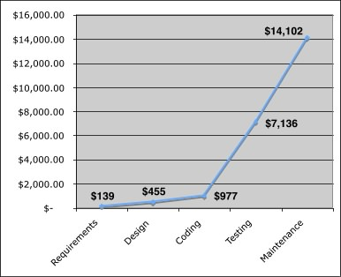
Cost of Quality
The relative costs to find and repair an error or defect increase dramatically as we go from prevention to detection to internal failure to external failure costs.

Slide 27
Quality and Risk
People bet their jobs, their comforts, their safety, their entertainment, their decisions, and their very lives on computer software. It better be right.”
Example:
Throughout the month of November, 2000 at a hospital in Panama, 28 patients received massive overdoses of gamma rays during treatment for a variety of cancers. In the months that followed, five of these patients died from radiation poisoning and 15 others developed serious complications. What caused this tragedy? A software package, developed by a U.S. company, was modified by hospital technicians to compute modified doses of radiation for each patient.

Slide 28
Quality and Security
Gary McGraw comments:
“Software security relates entirely and completely to quality. You must think about security, reliability, availability, dependability - at the beginning, in the design, architecture, test, and coding phases, all through the software life cycle [process]. Even people aware of the software security problem have focused on late life-cycle stuff. The earlier you find the software problem, the better. And there are two kinds of software problems. One is bugs, which are implementation problems. The other is software flaws - architectural problems in the design. People pay too much attention to bugs and not enough on flaws.”

Slide 29
Software Configuration Management (SCM)
Department of Computer Science and Engineering
School of Engineering, Presidency University

Slide 30
What is Software Configuration Management (SCM)
SCM is the task of tracking and controlling changes in the software.
If something in the project goes wrong, SCM can determine what was changed and who changed it.

Slide 31
What can Change in a Project?
changes in
business requirements
changes in
technical requirements
changes in
user requirements
other
documents
software models
Project
Plan
data
Test
code

Slide 32
Key aspects of SCM
Key aspects of SCM include:
Establishing a Baseline for the Project
Establishing a SCM Repository for the Project
Establishing the SCM Process which includes
Maintaining Change Control
Maintaining Version Control

Slide 33
1. Establishing a Baseline
The IEEE (IEEE Std. No. 610.12-1990) defines a baseline as:
A specification or product that has been formally reviewed and agreed upon, that thereafter serves as the basis for further development, and that can be changed only through formal change control procedures.
A Baseline is a milestone in the development of software that is marked by the delivery of one or more software configuration items and the approval of these SCIs that is obtained through a formal technical review

Slide 34
1. Establishing a Baseline

Slide 35
2. Establishing a SCM Repository
The SCM repository is the set of mechanisms and data structures that allow a software team to manage change in an effective manner
The repository performs or precipitates the following functions:
Data integrity
Information sharing
Tool integration
Data integration
Document standardization

Slide 36
2. SCM Repository Contents

Slide 37
3. Establishing the SCM Process for the Project
SCI – Software Configuration Item

Slide 38
3.1 Identification of SCI
SCI can include:
Business content
Model content
Construction content
V&V (Verification and Validation) content
Project Documents
[Refer ‘SCM Repository Content’ diagram on Slide 8]

Slide 39
3.2 Change Control Process
need for change is recognized
change request from user
developer evaluates
change report is generated
change control authority decides
request is queued for action
change request is denied
user is informed
change control process—II

Slide 40
3.2 Change Control Process
assign people to SCIs
check-out SCIs
make the change
review/audit the change
establish a “baseline” for testing
change control process—III

Slide 41
3.2 Change Control Process
perform SQA and testing activities
check-in the changed SCIs
promote SCI for inclusion in next release
rebuild appropriate version
review/audit the change
include all changes in release

Slide 42
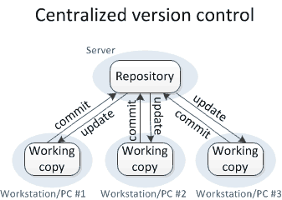
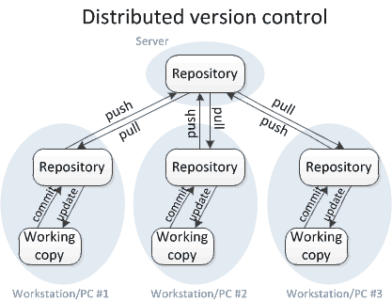
3.3 Version Control
Version control is a system that records changes to a file or set of files over time so that you can recall specific versions later.
Types: Centralized and Distributed Version Controls

Slide 43
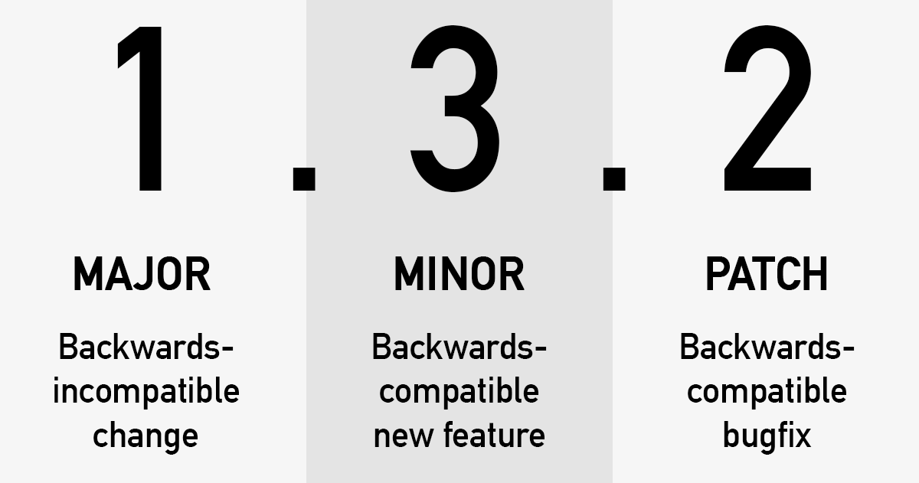
3.3 Numbers in a Version
A Version typically comprises of three numbers:
Major Version Number
Minor Version Number
Patch Number
Version Example

Slide 44
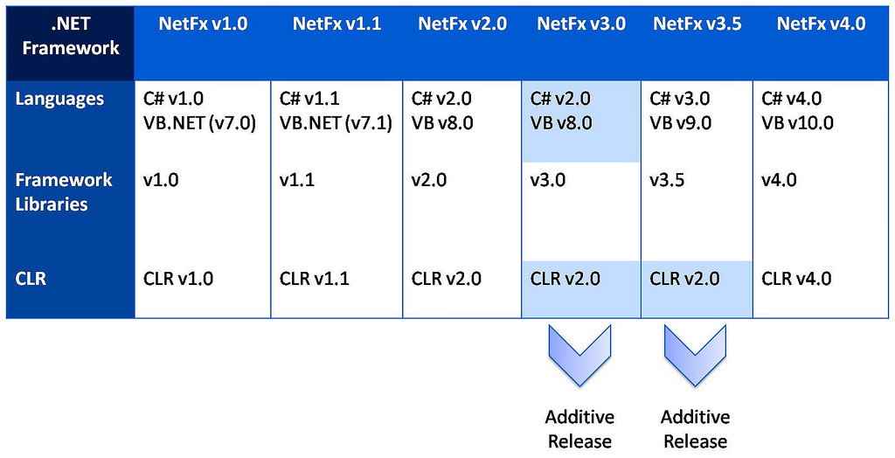
3.3 Versioning Example
Common Language Runtime
Versions

Slide 45
3.3 Popular Version Control Tools
Popular Version Control tools:
GIT
Team Foundation Server (Microsoft)
Rational Clear Case (IBM)
Visual SourceSafe (Microsoft)

Slide 46
3.4 SCM Auditing
SCM Auditing answers the following questions:
What is the SQA Plan followed for project?
How many SCIs were identified?
How many change requests were handled?
Change
Requests
SQA
Plan
SCIs
SCM Audit

Slide 47
3.5 Reporting
The reporting aspect of the SCM process provides timely information on the status of the changes requested and the SCIs to the people who may be affected by the changes.
These could be the people requesting for changes, the developers, the project manager, and the senior management.

Slide 48
Case Study
For the University Project,
What SCIs would you identify?
Explain the change control process that you would adopt? Explain for a single identified SCI?
How many versions of your project is required, before final submission. Justify your answer.

